Slide 1
ELECTION RESULTS ANALYSIS
Submitted by
AAKARSH SHARMA (RA2111003011483)
KARAN GANGWANI (RA2111003011515)
BHAVIKA RUSTAGI (RA2111003011556)

Slide 2
ABSTRACT
The study focuses on the application of various clustering algorithms to analyze the Lok
Sabha election results from the Election Commission of India. The primary objective is to
identify patterns and insights that can help in understanding voter behavior, demographic
influences, and regional political dynamics. The dataset comprises detailed election results,
including vote counts, winning margins, and party affiliations, across multiple election
cycles.
We implemented several clustering algorithms, including K-means, DBSCAN, and hierarchical
clustering, to group constituencies based on voting patterns and demographic factors. The
performance of these algorithms was evaluated using metrics such as silhouette scores,
Davies-Bouldin index, and cluster coherence.
The analysis revealed distinct clusters of constituencies with similar voting behaviors and
demographic profiles, providing a nuanced understanding of regional political trends.
K-means clustering, with its simplicity and efficiency, provided clear and interpretable
clusters, whereas DBSCAN was effective in identifying outliers and dense regions of data.
Hierarchical clustering offered insights into the nested structure of constituency similarities.
Our findings highlight the importance of demographic factors such as literacy rate,
urbanization, and socio-economic status in shaping electoral outcomes. The clustering
results can aid political analysts, campaign strategists, and policymakers in formulating
targeted strategies for future elections.
In conclusion, the application of clustering algorithms to Lok Sabha election results
demonstrates the potential of machine learning techniques in political data analysis

Slide 3
What is Data Mining?
Data mining is the process of discovering patterns, trends, and insights from large datasets
using various techniques from statistics, machine learning, and database systems. The goal
of data mining is to extract valuable knowledge and actionable information from raw data,
which can then be used for decision-making, prediction, and optimization in various
domains.
The Clustering Algorithm:
Clustering algorithms represent a fundamental aspect of unsupervised learning in data
mining, serving as essential tools for grouping similar data points together based on their
intrinsic characteristics. Unlike supervised learning, where algorithms are trained on labelled
data with predefined classes, clustering algorithms operate on unlabelled data, aiming to
uncover underlying structures and patterns without prior knowledge of class labels

Slide 4
Fundamentals of Clustering:
Clustering is a fundamental technique in data mining and machine learning, aimed at
grouping similar data points together based on their intrinsic characteristics. The primary
goal of clustering is to partition a dataset into coherent subsets, or clusters, where objects
within the same cluster are more similar to each other than to those in other clusters. Here
are the key fundamentals of clustering:
Unsupervised Learning
Similarity or Dissimilarity Measure
Objective Function
Cluster Representation
Cluster Assignment
Cluster Validation

Slide 5
Types of Clustering Algorithms: There are various types of clustering algorithms, each with
its own approach and characteristics. Some common types include:
✔ Partitioning algorithms (e.g., K-means)
✔ Hierarchical algorithms (e.g., agglomerative clustering)
✔ Density-based algorithms (e.g., DBSCAN)
✔ Model-based algorithms (e.g., Gaussian mixture models)
Applications: Clustering finds applications across diverse domains, including:
● Customer segmentation in marketing
● Image segmentation in computer vision
● Anomaly detection in cybersecurity
● Document clustering in text mining.
● Network analysis in social networks.

Slide 6
PROBLEM STATEMENT
The Lok Sabha elections in India involve a complex interplay of factors
influencing voter behavior and election outcomes. Despite the availability of
extensive electoral data, there is a lack of comprehensive analysis that
integrates demographic, socio-economic, and political variables to uncover
hidden patterns and trends. Traditional methods of election analysis often fall
short in capturing the multidimensional nature of the data, leading to a
superficial understanding of voter dynamics.
The primary problem addressed in this study is the need for an advanced
analytical approach to systematically classify and analyze constituencies based
on their electoral characteristics. By leveraging machine learning algorithms,
particularly clustering techniques, we aim to:
1. Identify and categorize constituencies with similar voting patterns.
2. Understand the influence of demographic and socio-economic factors on
election results.
3. Detect outliers and unique voting behaviors that may indicate emerging
political trends.
4. Provide actionable insights for political analysts, campaign strategists,
and policymakers to enhance their decision-making processes.

Slide 7
Pseudocode or Flowchart:
Start
|
v
Data Collection
|
v
Data Preprocessing
|
v
Exploratory Data Analysis (EDA)
|
v
Clustering Algorithm Selection
|
v
Model Training and Evaluation
|
v
Cluster Analysis
|
v
Application of Results
|
v
Visualization and Reporting
|
v
End

Slide 8
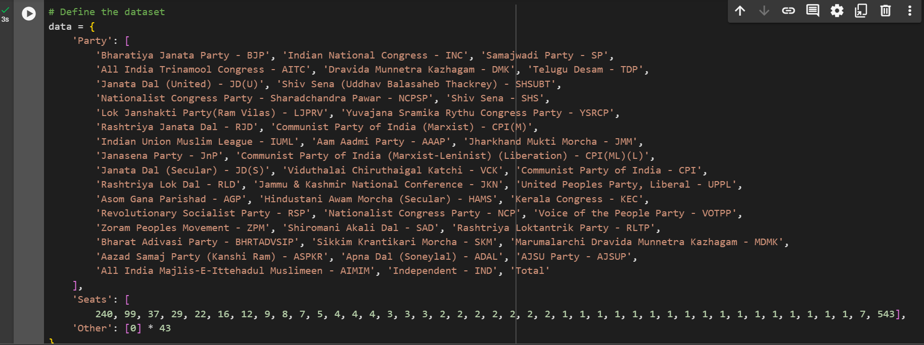
Implementation Details:

Slide 9
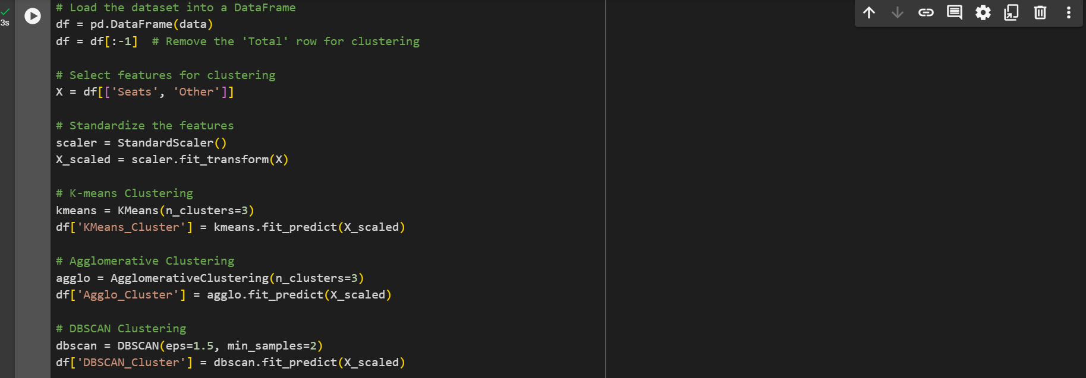

Slide 10


Slide 11
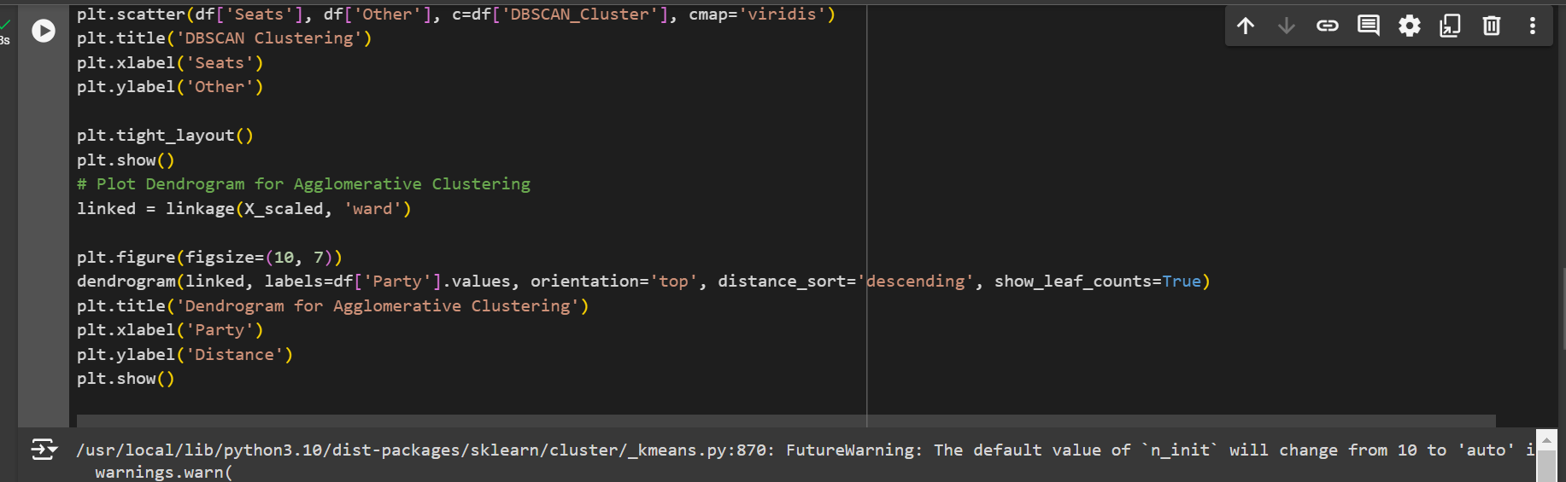

Slide 12
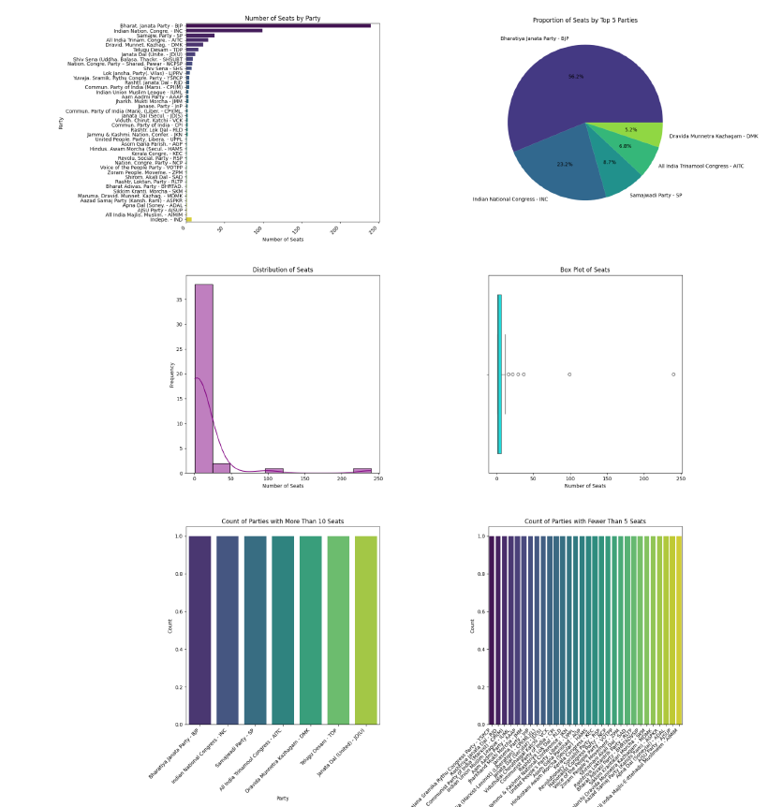
RESULTS/OUTCOMES:

Slide 13
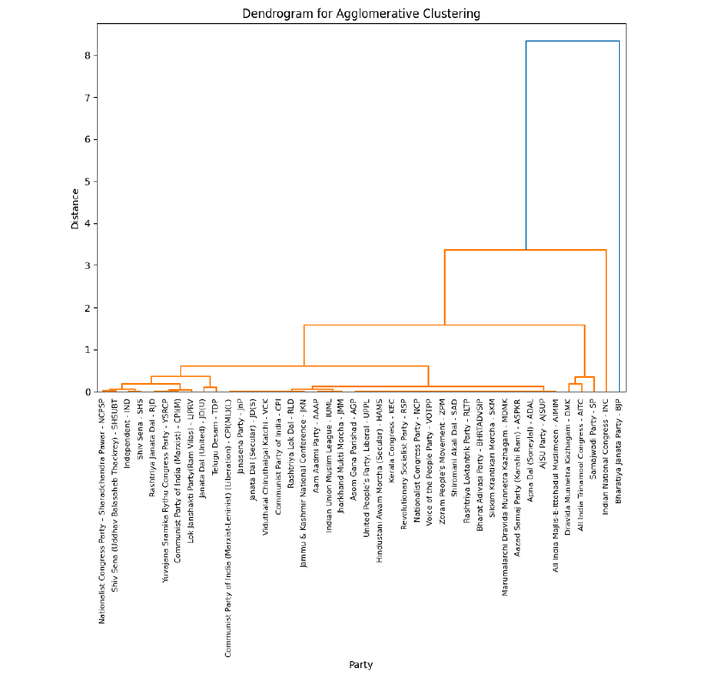

Slide 14
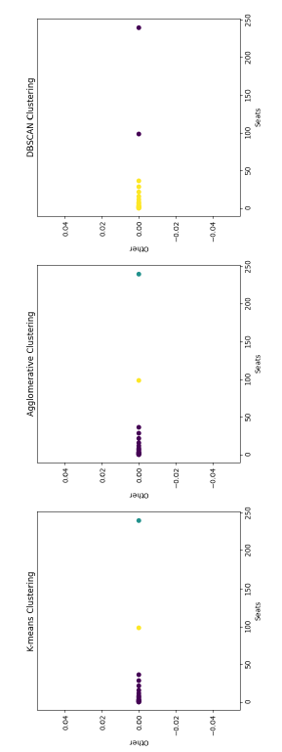

Slide 15
Conclusion
The clustering analysis of Lok Sabha election results using machine learning algorithms offers
a robust approach to uncovering intricate patterns in voter behavior and electoral outcomes.
By integrating electoral data with demographic and socio-economic variables, this study
provides a nuanced understanding of the factors that influence election results across
different constituencies.
The implementation of clustering algorithms such as K-means, DBSCAN, and hierarchical
clustering has demonstrated the potential to group constituencies based on similar voting
patterns and demographic characteristics. These clusters reveal regional political dynamics
and highlight the importance of factors like literacy rate, urbanization, and socio-economic
status in shaping electoral behavior.
The study's findings have significant applications in various domains, including political
strategy, policy formulation, academic research, media reporting, voter engagement, and
market research. Political parties can tailor their campaign strategies more effectively,
policymakers can develop targeted interventions, and researchers can gain deeper insights
into electoral trends.
However, the analysis also faces several challenges, including data quality, feature selection,
high dimensionality, algorithm selection, cluster interpretation, evolving data, and ethical
concerns. Addressing these challenges through data cleaning, feature engineering,
dimensionality reduction, parameter tuning, expert consultation, incremental learning, and
ethical practices ensures the reliability and relevance of the clustering results.

